Slide 1
Fundamentals of Data Science
Ch 4: Text mining and text analytics
First Semester 2022/2023

Slide 2
This chapter covers:
Understanding the importance of text mining
Introducing the most important concepts in text mining
Working through a text mining project

Slide 3
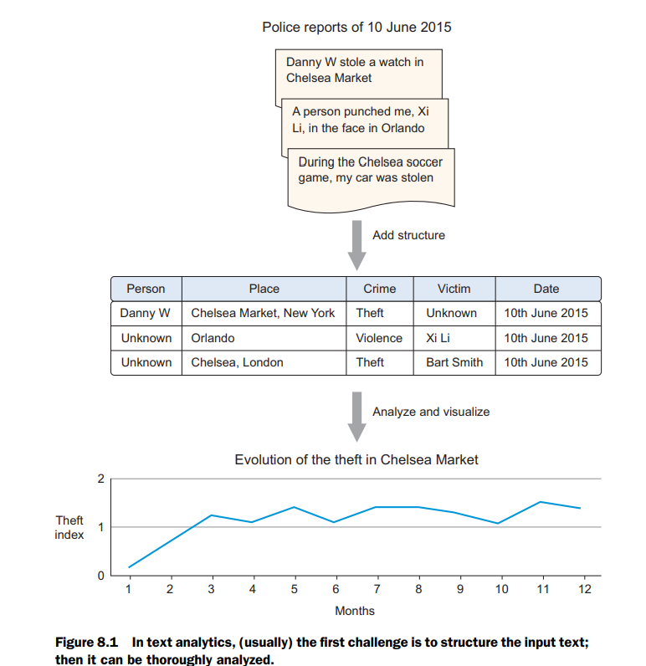
Text mining
Text mining or text analytics is a discipline that combines language science and computer science with statistical and machine learning techniques.
Text mining is used for analyzing texts and turning them into a more structured form. Then it takes this structured form and tries to derive insights from it. When analyzing crime from police reports, for example, text mining helps you recognize persons, places, and types of crimes from the reports. Then this new structure is used to gain insight into the evolution of crimes.

Slide 4
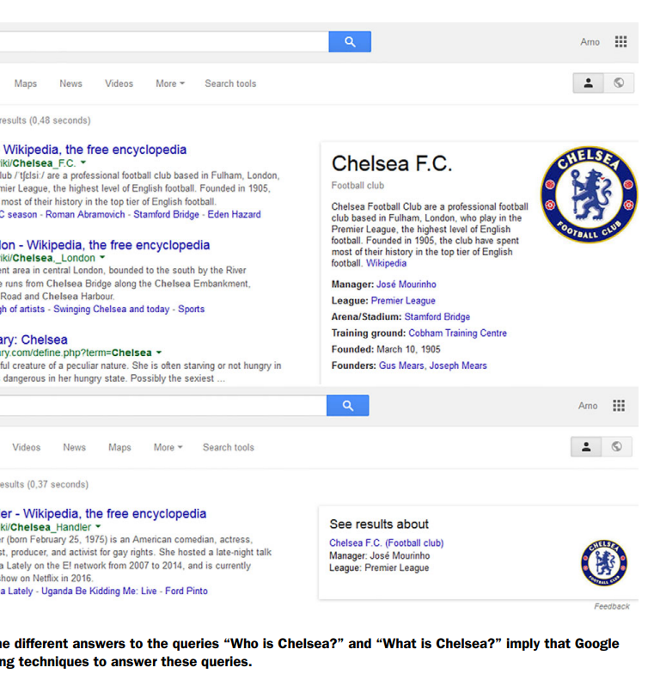
Text mining in the real world
In your day-to-day life you’ve already come across text mining and natural language applications. Autocomplete and spelling correctors are constantly analyzing the text you type before sending an email or text message.
When Facebook autocompletes your status with the name of a friend, it does this with the help of a technique called named entity recognition, although this would be only one component of their repertoire.
The goal isn’t only to detect that you’re typing a noun, but also to guess you’re referring to a person and recognize who it might be. Another example of named entity recognition is shown in figure 8.2. Google knows Chelsea is a football club but responds differently when asked for a person.

Slide 5
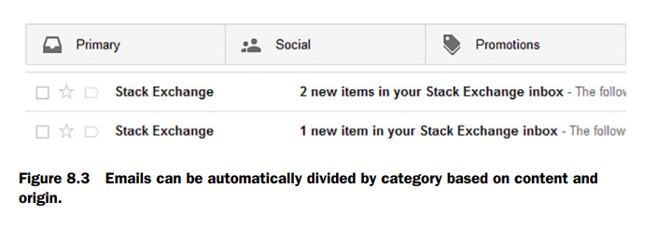
Text mining in the real world
Google uses many types of text mining when presenting you with the results of a query. What pops up in your own mind when someone says “Chelsea”? Chelsea could be many things: a person; a soccer club; a neighborhood in Manhattan, New York or London; a food market; a flower show; and so on. Google knows this and returns different answers to the question “Who is Chelsea?” versus “What is Chelsea?” To provide the most relevant answer, Google must do (among other things) all of the following:
■ Preprocess all the documents it collects for named entities
■ Perform language identification
■ Detect what type of entity you’re referring to
■ Match a query to a result
■ Detect the type of content to return (PDF, adult-sensitive)
This example shows that text mining isn’t only about the direct meaning of text itself but also involves meta-attributes such as language and document type. Google uses text mining for much more than answering queries. Next to shielding its Gmail users from spam, it also divides the emails into different categories such as social, updates, and forums, as shown in figure8.3.
It’s possible to go much further than answering simple questions when you combine text with other logic and mathematics

Slide 6
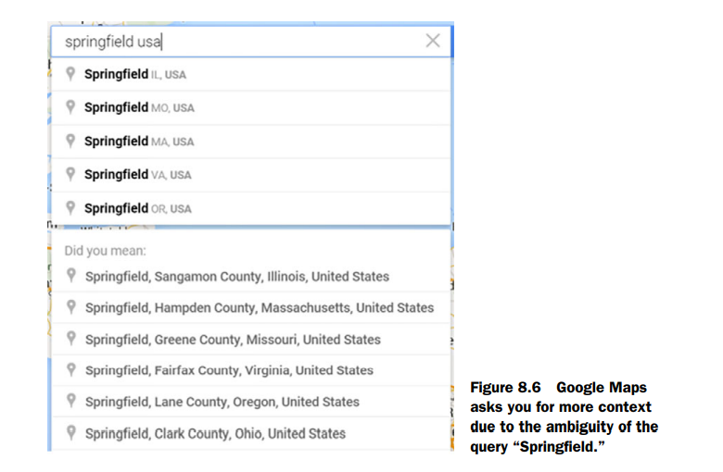
Text mining applications
Text mining has many applications, including, but not limited to, the following:
Entity identification
Plagiarism detection
Topic identification
Text clustering
Translation
Automatic text summarization
Fraud detection
Spam filtering
Sentiment analysis

Slide 7
Text Mining Concepts
85-90 percent of all corporate data is in some kind of unstructured form (e.g., text)
Unstructured corporate data is doubling in size every 18 months
Tapping into these information sources is not an option, but a need to stay competitive
Answer: text mining
A semi-automated process of extracting knowledge from unstructured data sources
a.k.a. text data mining or knowledge discovery in textual databases

Slide 8
Text Analytics and Text Mining

Slide 9
Data Mining versus Text Mining
Both seek for novel and useful patterns
Both are semi-automated processes
Difference is the nature of the data:
Structured versus unstructured data
Structured data: in databases
Unstructured data: Word documents, PDF files, text excerpts, XML files, and so on
Text mining – first, impose structure to the data, then mine the structured data.

Slide 10
Text Mining Concepts
Benefits of text mining are obvious, especially in text-rich data environments
e.g., law (court orders), academic research (research articles), finance (quarterly reports), medicine (discharge summaries), biology (molecular interactions), technology (patent files), marketing (customer comments), etc.
Electronic communication records (e.g., Email)
Spam filtering
Email prioritization and categorization
Automatic response generation

Slide 11
Natural Language Processing (NLP)
Structuring a collection of text
Old approach:
Bag of Words comprises 2 things
A vocabulary of known words.
A measure of the presence of known words.
It is a “Bag” because the order and structure of words is removed
Only looks for the occurrence of words not their order
New approach: natural language processing
NLP is …
a very important concept in text mining
a subfield of artificial intelligence and computational linguistics
the studies of "understanding" the natural human language
Syntax versus semantics-based text mining
Syntax – the arrangement of words to form a sentence
Semantics – the study of meaning. Destination/last stop

Slide 12
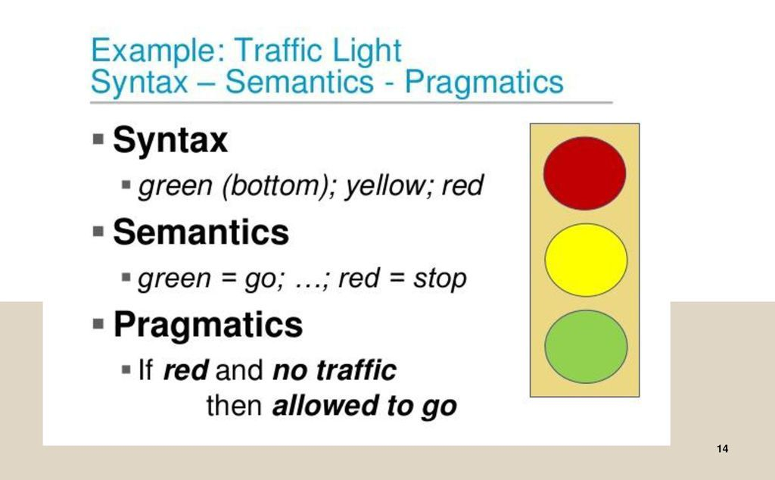

Slide 13
Natural Language Processing (NLP)
WordNet
A laboriously hand-coded database of English words, their definitions, sets of synonyms, and various semantic relations between synonym sets.
A major resource for NLP.
Need automation to be completed.
Sentiment Analysis
A technique used to detect favorable and unfavorable opinions toward specific products and services
SentiWordNet

Slide 14
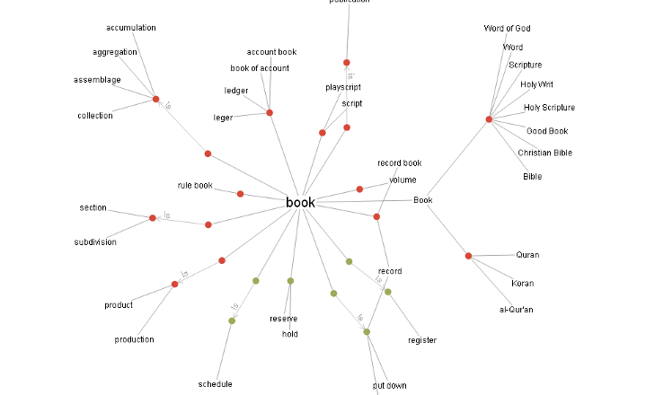

Slide 15
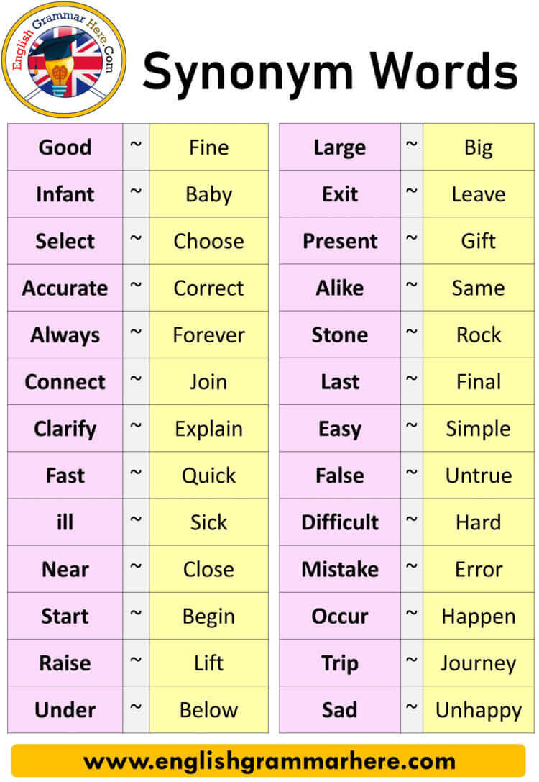

Slide 16


Slide 17
Text Mining Process
The three-step text mining process

Slide 18
Text Mining Process
Step 1: Establish the corpus
Collect all relevant unstructured data (e.g., textual documents, XML files, emails, Web pages, short notes, voice recordings…)
Digitize, standardize the collection (e.g., all in ASCII text files)
Place the collection in a common place (e.g., in a flat file, or in a directory as separate files)

Slide 19
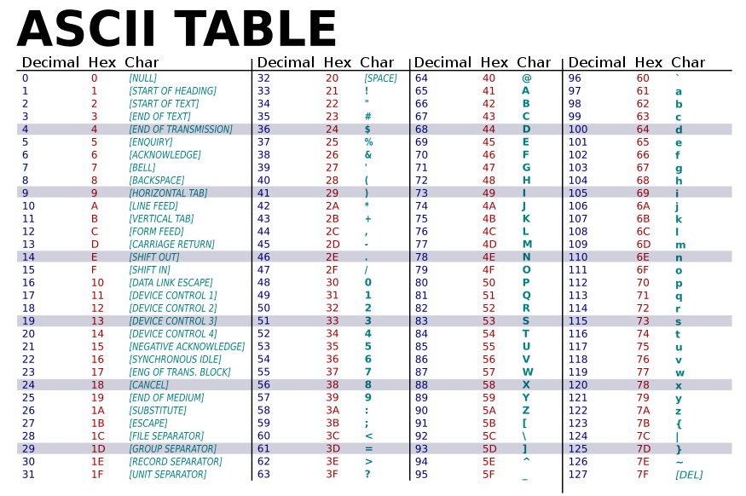

Slide 20
Text Mining Process
Step 2: Create the Term-by-Document Matrix (TDM)
Should all terms be included?
Stop words, include words
Synonyms, homonyms
Stemming
What is the best representation of the indices (values in cells)?
Row counts; binary frequencies; log frequencies;
Inverse document frequency

Slide 21
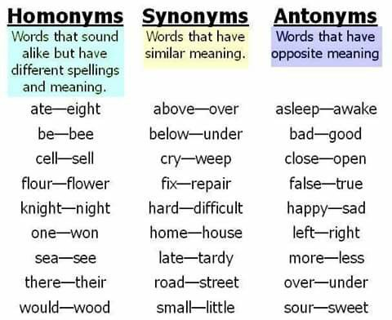

Slide 22
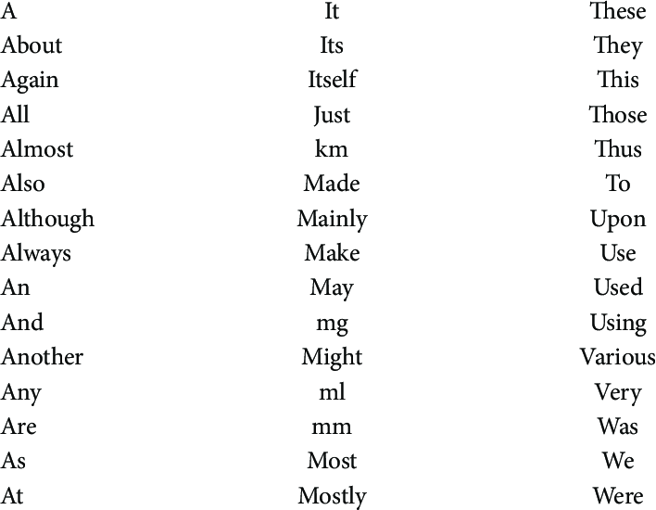
Stop words

Slide 23
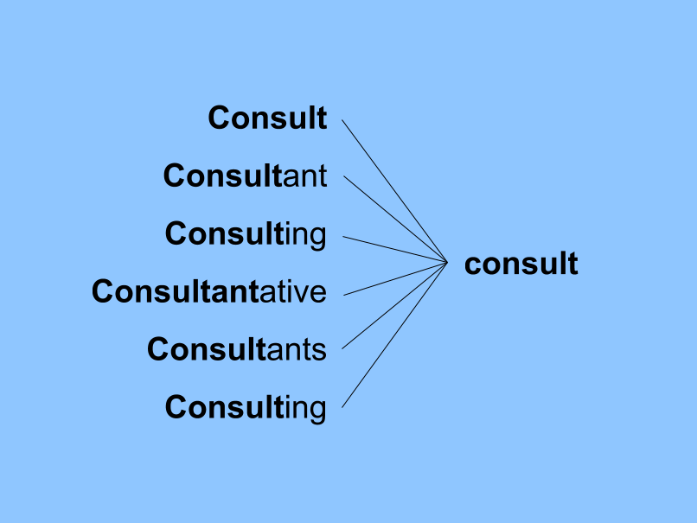
Stemming

Slide 24
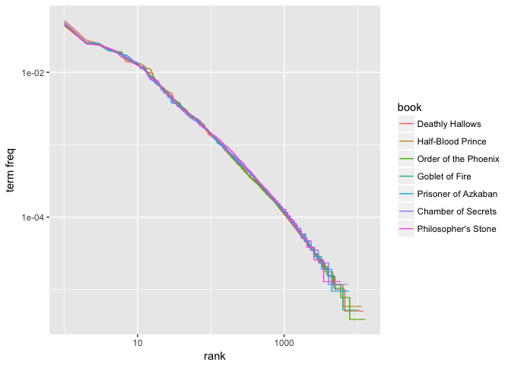
log frequencies

Slide 25
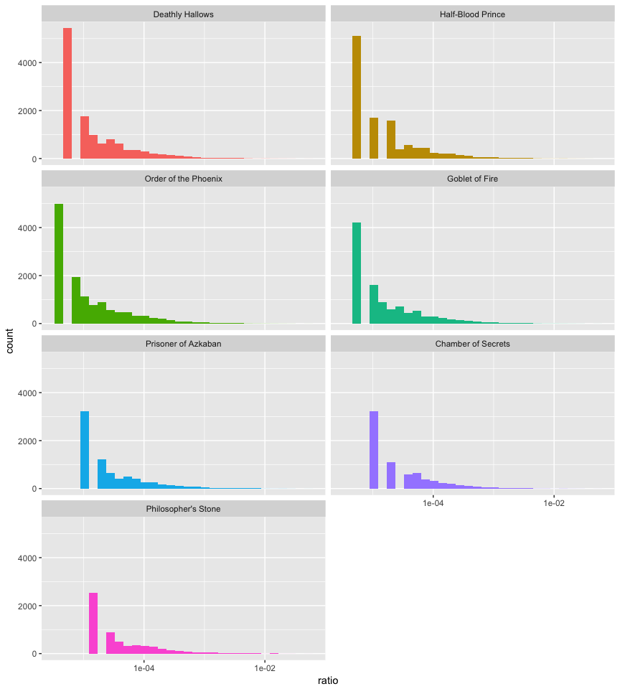
binary frequencies

Slide 26
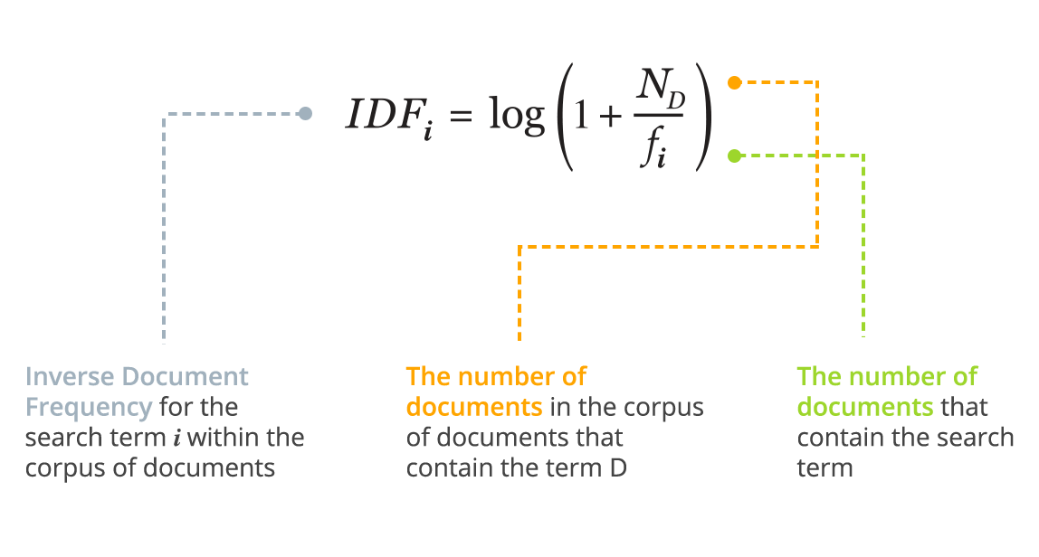
Inverse document frequency

Slide 27
Text Mining Process
Step 2: Create the Term-by-Document Matrix (TDM)

Slide 28
Text Mining Process
Step 3: Extract patterns/knowledge
Classification (text categorization)
Clustering (natural groupings of text)
Improve search recall
Improve search precision
Scatter/gather
Query-specific clustering
Association
Trend Analysis (…)

